Slide 1
Equations of a straight line.

Slide 2
Warm up
Find the gradient of the following lines:
A)
B)
2
2
1
3
c)
-2
3

Slide 3
The gradient of a road is the same as its slope or how steep the road is
2 m
30 m

Slide 4
Gradient of a line
The Gradient measures the “rise or increase in y” and “run or increase in x” of the stairs beneath or above the line.
4
4

Slide 5
Gradient of a line
The “stairs” on the same line are the same steepness or gradient.

Slide 6
Gradient of a line
Can I make a line if the stairs aren’t the same size?
No. So it doesn’t matter where on the line I measure the steepness of the slope, it will always be the same as long as the line is straight

Slide 7

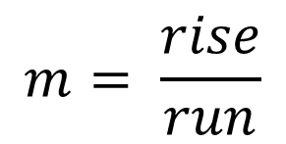
Gradient of a line (m)
To find the gradient, use the formula
4
$$m= \frac{rise}{run}$$
4
$m= \frac{4}{4}=$1

Slide 8
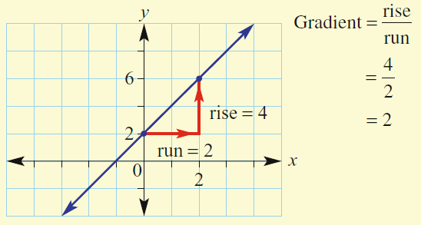
Topic: Equation of a Straight Line.
EQ: How do we find the Equation of a Straight Line.
To find the equation of any straight line we require to know 2 things:
(1) The gradient of the line.
(2) The y - intercept of the line (where the line crosses the y-axis)
The equation of a straight line is :
y = mx + c
gradient
y-intercept
y-intercept = 2
y = 2x + 2

Slide 9



y=mx + c
8
7
6
5
4
y intercept = 2
Rise = +1
2
3
2
1
Run = 2
$$\frac{1}{2}$$
-1
m = $\frac{Rise}{Run2}$ $= \frac{1}{2}$
-2
-3
-4
-5
So y= $\frac{1}{2}$x + 2
-6
-7
-8

Slide 10



y=mx + c
8
7
6
5
4
y intercept = 1
Rise = +3
1
3
2
1
Run = 4
$$\frac{3}{4}$$
-1
m = $\frac{Rise}{Run}$ $= \frac{3}{4}$
-2
-3
-4
-5
So y= $\frac{3}{4}$x + 1
-6
-7
-8

Slide 11



y=m x + c
8
7
6
5
4
y intercept = 3
Rise = -1
3
3
2
1
Run = 2
$$−\frac{1}{2}$$
-1
m = $\frac{Rise}{Run}$ $= \frac{−1}{2}$
-2
-3
-4
-5
So y=$−\frac{1}{2}$x + 3
-6
-7
-8

Slide 12
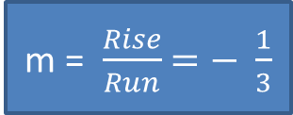


y=m x + c
8
7
6
5
4
y intercept = 4
Rise = -1
4
3
2
1
Run = 3
$$−\frac{1}{3}$$
-1
m = $\frac{Rise}{Run}$ $=− \frac{1}{3}$
-2
-3
-4
-5
-6
So y=$−\frac{1}{3}$x + 4
-7
-8

Slide 13
Practice time. Complete the worksheet

